Slide 1
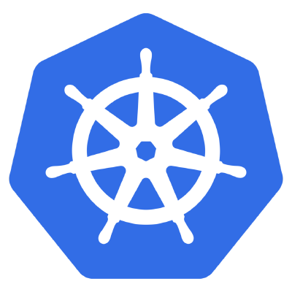

What are Containers?
Brought to you by

Slide 2
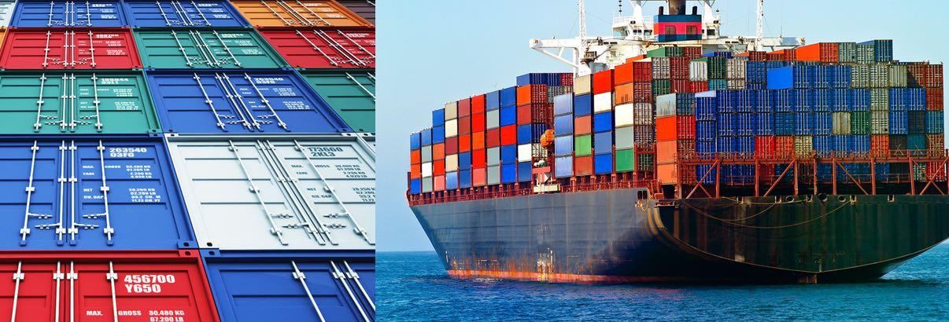
Physical Shipping containers:

Slide 3
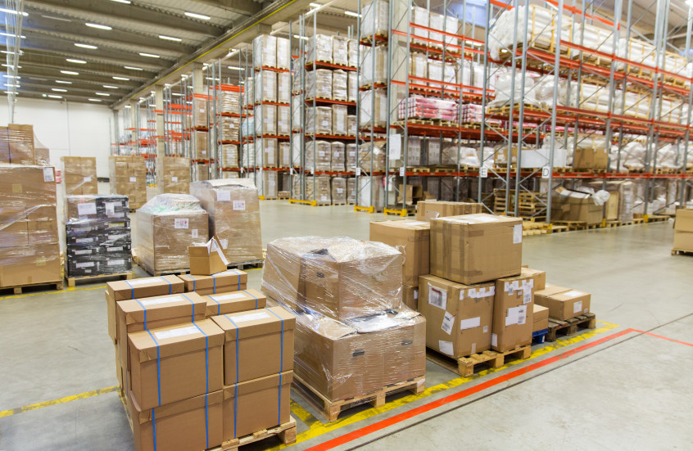
Various different sized packages

Slide 4
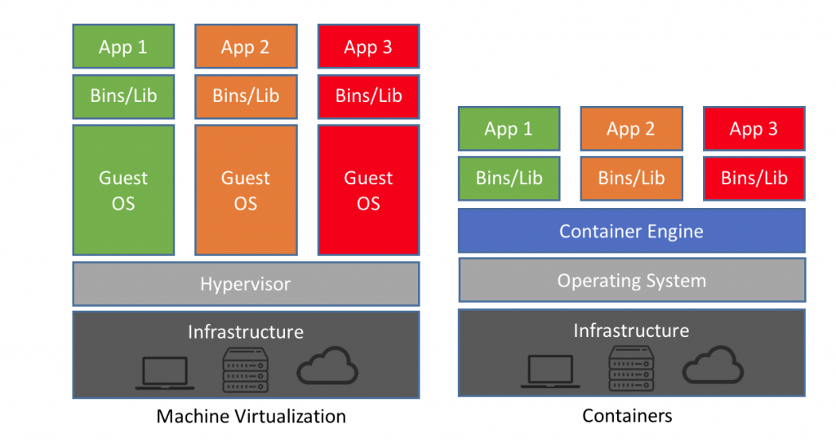
Virtual machines vs Containers
Virtual machines emulate an entire operating system
Each virtual machine uses its own kernel
All containers share the same container engine and share one kernel
Containers are far more lightweight than virtual machines

Slide 5
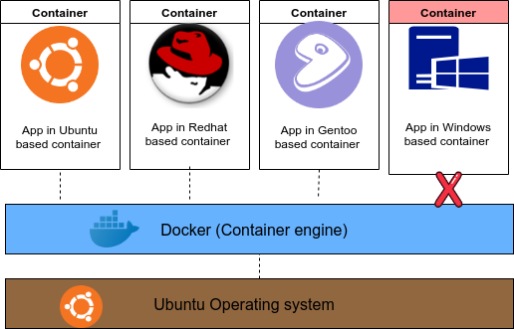
Sharing the same kernel in containers
Containers can be based on different operating systems.
The container engine shares the host system’s kernel.
The container engine can run many different containers based on many operating systems provided the operating system is based on the same kernel as the host system.
A Linux based host running docker (container engine) cannot run a Windows based container

Slide 6
Why containers?
Smaller footprint than virtual machines
Application containers utilize less memory, disk space and cpu than virtual machines
Containers are easier to ship.
Since containers are standardized the applications are easily shipped from machine to machine (server, desktop, cloud infrastructure))
Standardized development environments = less DevOps headaches.
More consistent and agile development environments..

